Slide 1
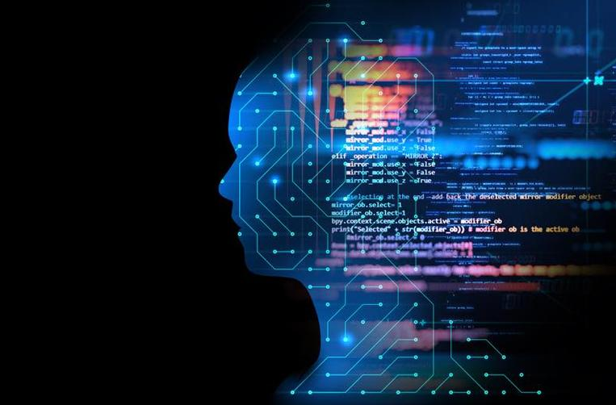

Slide 2

Artificial Intelligence
How AI makes your life easier?
Notes:
https://www.slideshare.net/EdurekaIN/what-is-artificial-intelligence-artificial-intelligence-tutorial-for-beginners-edureka/42-Copyright_2017_edureka_andor_its

Slide 3
Outlines
01
Introduction
02
Applications
03
Basic Concept
04
Simple Tips

Slide 4
About
Me

Slide 5

ZENDI
IKLIMA
Data Scientists, System Architect and Development
ABOUT
My interest area are data scientists for data mining, cloud computing, image processing, text processing, IoTaaS, CPaaS, PBaaS, robotic and control system.

Slide 6
My RoadMap
2018
2015
Graduation
Lecturer
Lecturer of Electrical Engineering in Mercu Buana University
Bachelor Degree of Electrical Engineering
Mercu Buana University
Bachelor Degree of Computer Science
Esa Unggul University
2014
2016
Now
System Architect
Master Program
Master Degree of Software Engineering Beijing Institute of Technology
Building Campus Block-Chain System, DNNs for Fooling System, Text Processing using NLP, SVMs, Naïve Bayes, etc
Co-Founder
Build a clinical system for a hospital
Indonesian Diaspora Connect

Slide 7
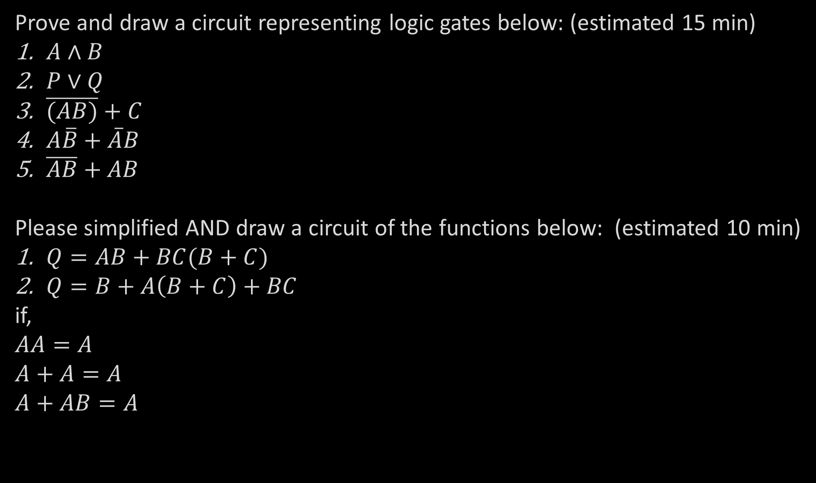
Prove and draw a circuit representing logic gates below: (estimated 15 min)
$A∧B$
$P∨Q$
$\overline{(AB)}+C$
$A\overline{B}+\overline{A}B$
$\overline{AB}+AB$
Please simplified AND draw a circuit of the functions below: (estimated 10 min)
$Q=AB+BC(B+C)$
$Q=B+A\left(B+C\right)+BC$
if,
$AA=A$
$A+A=A$
$A+AB=A$

Slide 8
Beginning of Logic (Rule of Assumptions)
CONJUCTION (&)
DISJUCTION (v)
Modus Ponendo Ponens (MPP)
Modues Tollendo Tollens (MTT)
Double Negation (DN)
Conditional Proof (CP)
&-Introduction (&I)
&-Elimination (&E)
v-Introduction (vI)
v-Elimination (vE)
Reductio ad Absurdum (RAA)
Biconditional
Theorem Introduction (TI)
Sequent Introduction (SI)
The Introduction of Universal Quantifier
The Elimination of Universal Quantifier
The Introduction of Existential Quantifier
The Eliminationof Existential Quantifier

Slide 9
What is
Artificial Intelligence?

Slide 10
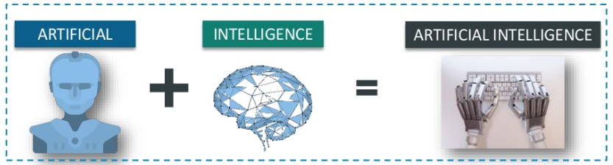
ARTIFICIAL
INTELLIGENCE
Definition
Artificial Intelligence is intelligence exhibited by machines, rather than humans. The field of AI research defines itself as the study of “intelligent agents”: any device that perceives its environment and takes actions that maximize its chance of success at some goal

Slide 11
PRO
&
CONTRA

Slide 12
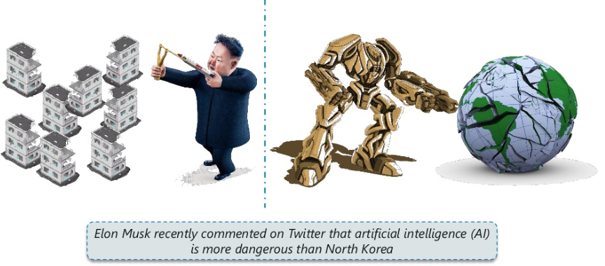
as a Threat

Slide 13
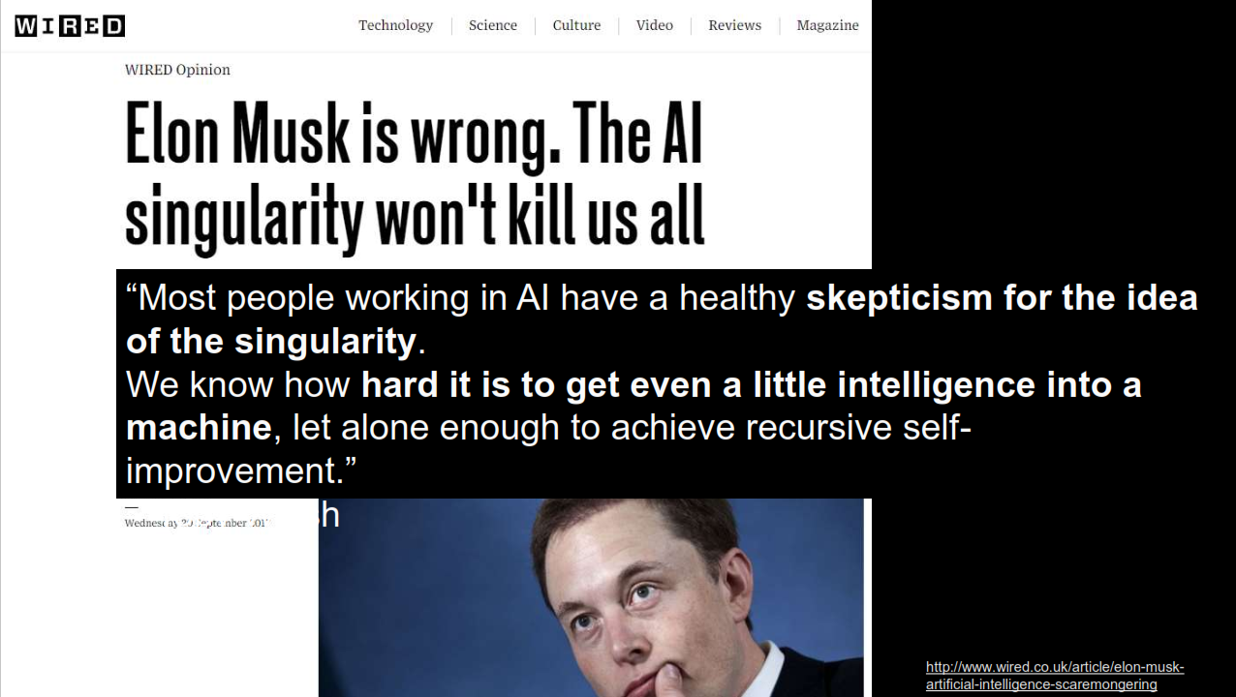
as a Threat

Slide 14
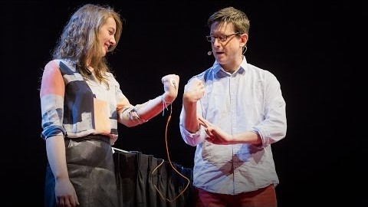

Slide 15
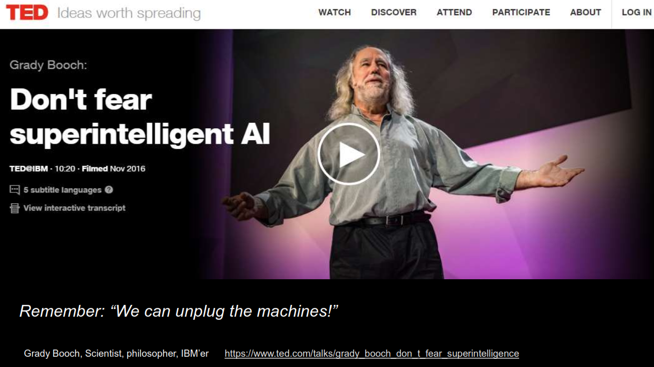
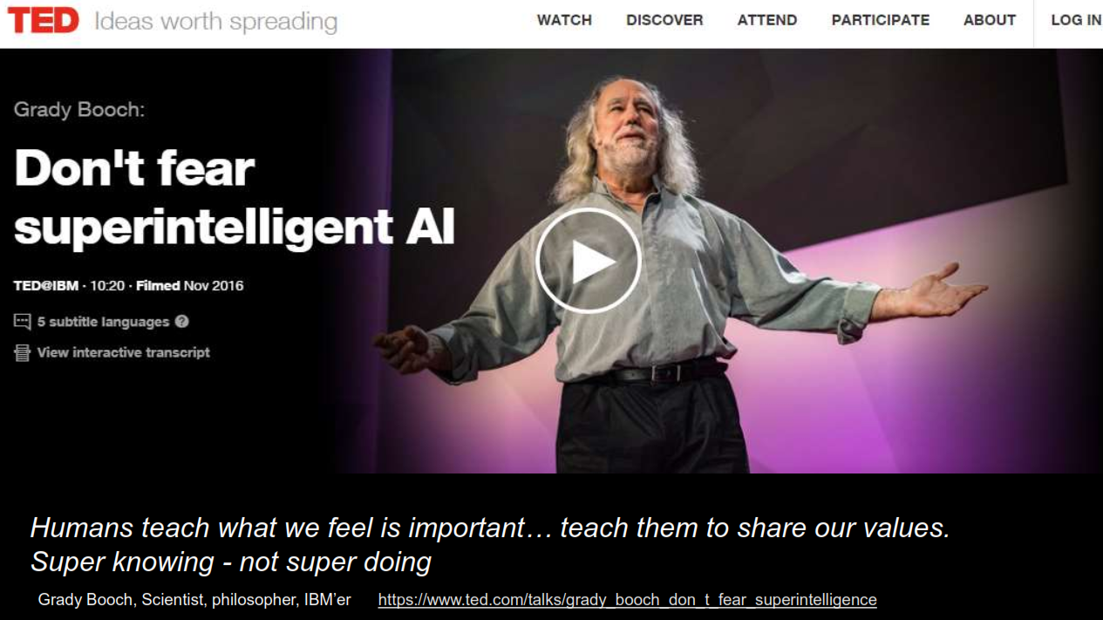
as a Threat

Slide 16
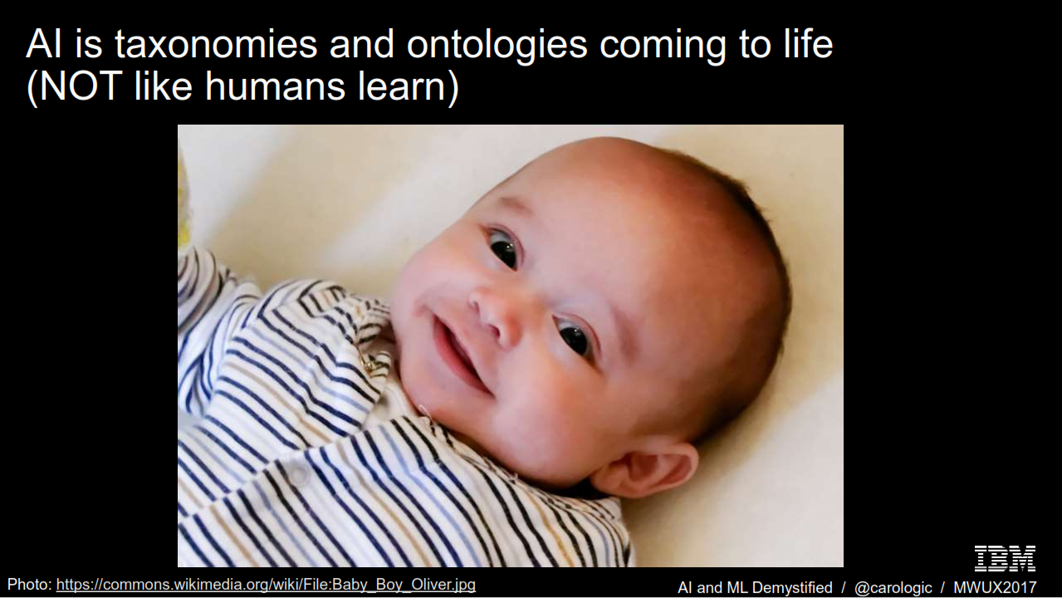
as a Threat

Slide 17
is it
NEW?

Slide 18
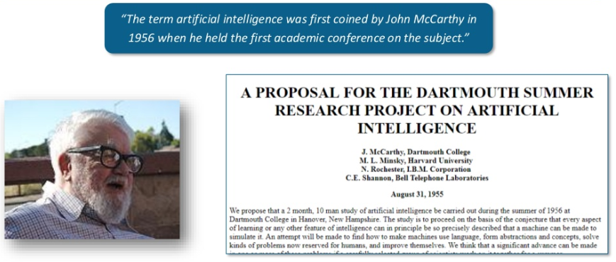
Brief History

Slide 19
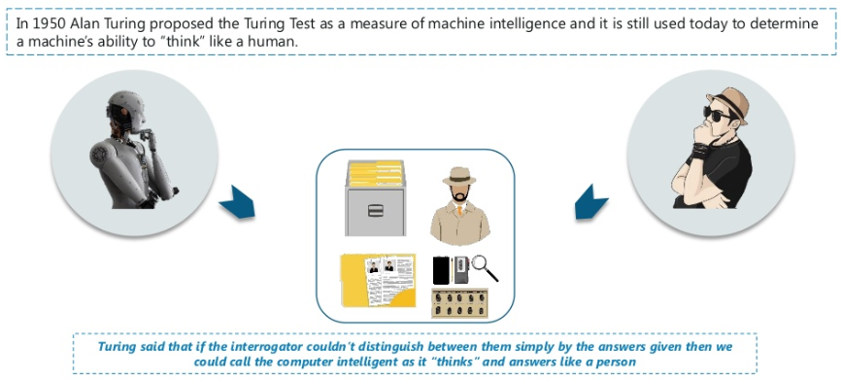
Brief History

Slide 20
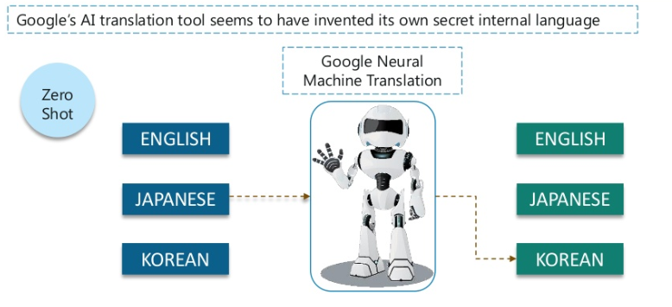
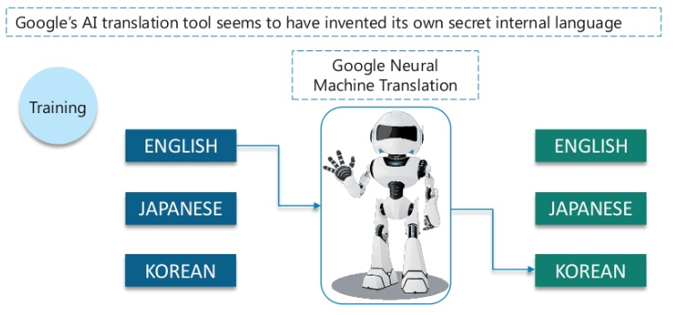
as a Threat
In 2016 GMT changed to GNMT supported by ANN (for DL) improves EBMT

Slide 21
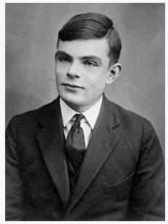
Brief History
He was an English mathematician, computer scientist, logician, cryptanalyst, philosopher, and theoretical biologist.
Turing was highly influential in the development of theoretical computer science, providing a formalization of the concepts of algorithm and computation with the Turing machine, which can be considered a model of a general-purpose computer.
Turing is widely considered to be the father of theoretical computer science and artificial intelligence.
June 12 – June 1954

Slide 22
Whether AI influences us?

Slide 23
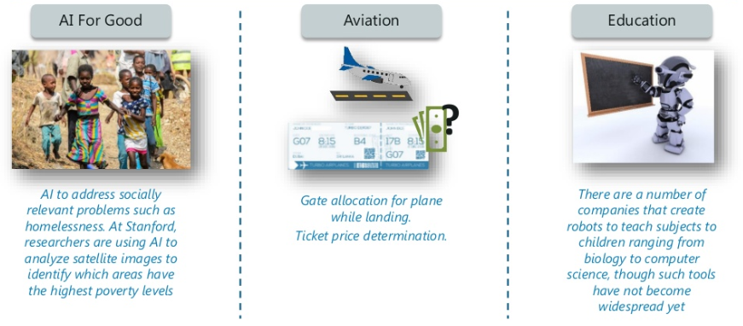
Use-Cases

Slide 24
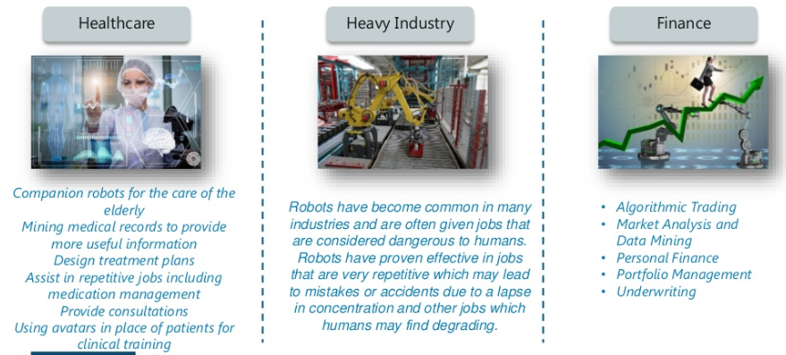
Use-Cases

Slide 25
Applications

Slide 26
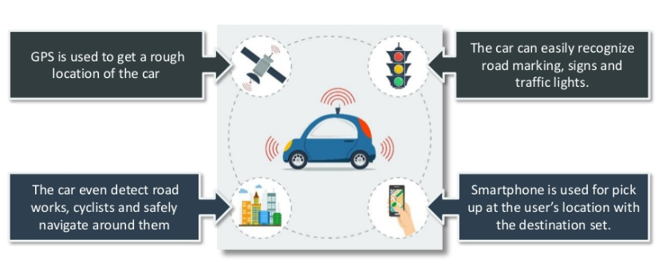
Applications

Slide 27
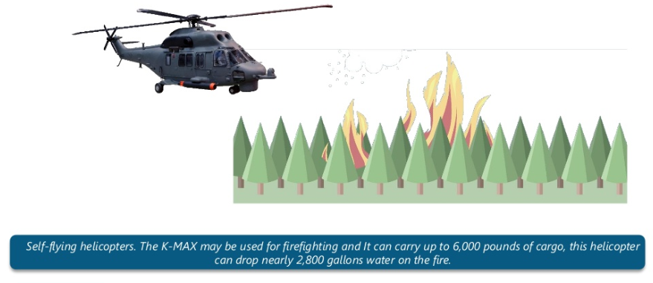
Applications

Slide 28
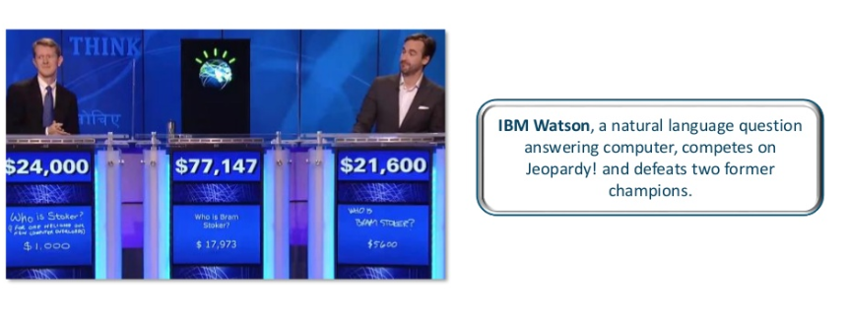
Applications

Slide 29
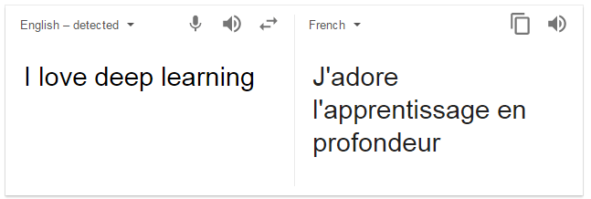

Applications
Notes:
https://www.edureka.co/blog/what-is-deep-learning

Slide 30
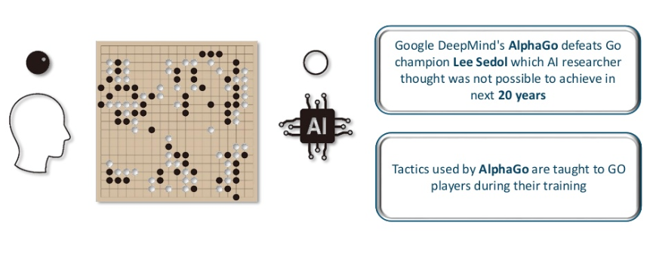
Applications

Slide 31
Why?

Slide 32
AI-Driven Enterprise
Simplicity
Growth
Rapid, automated decision-making, simplifies business process execution
Eliminating complexity increases agility
Accuracy
Relevance
Decisions based on data not intuition. Human bias and risk are eliminated
Constant analytics improves customer service through relevant customer dialogs
Notes:
Rapid cepat
Agile lincah

Slide 33
Ways of achieving in

Slide 34
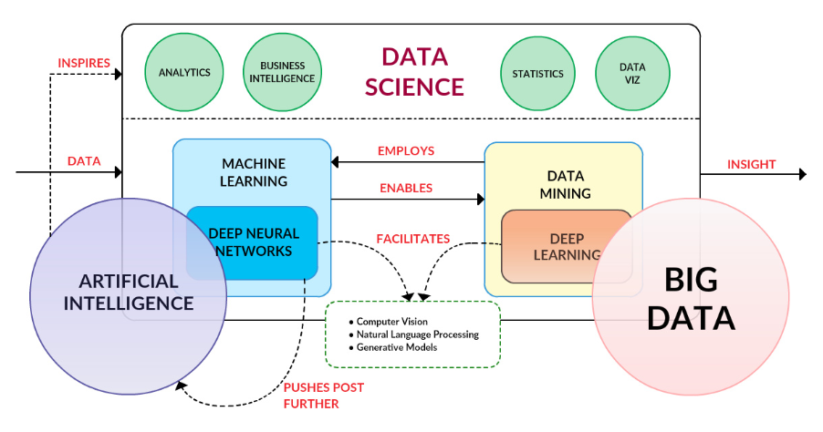
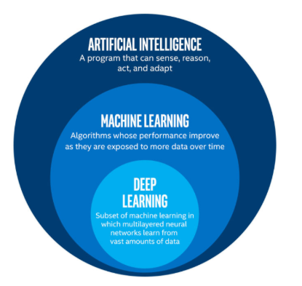
Subsets

Slide 35
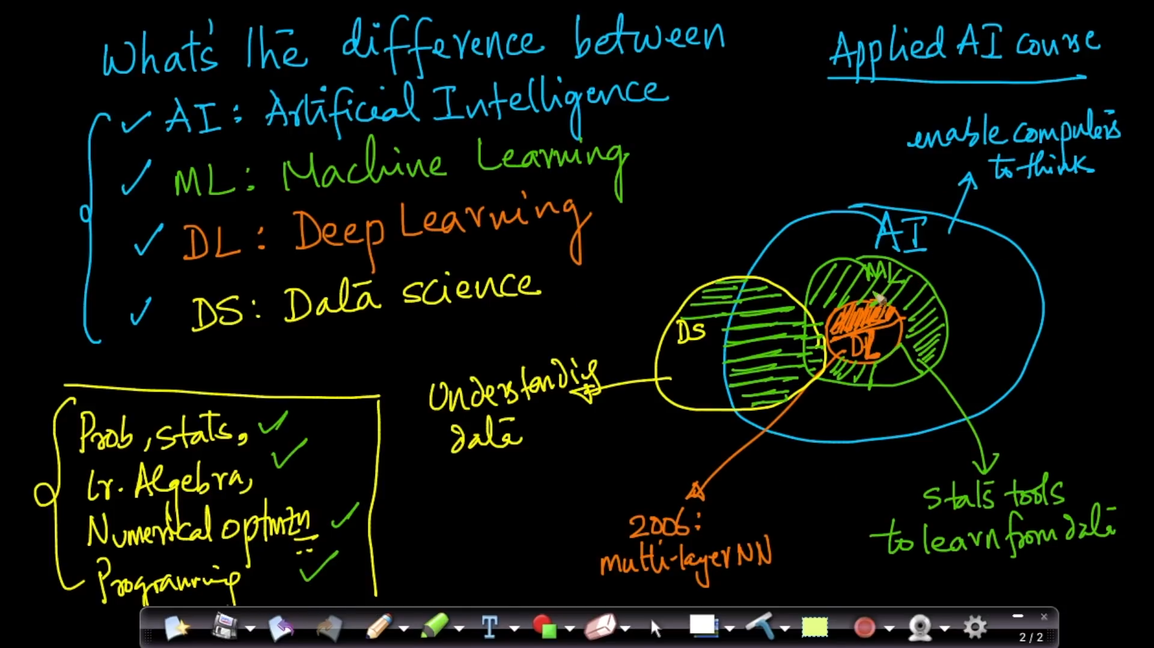
Subsets

Slide 36
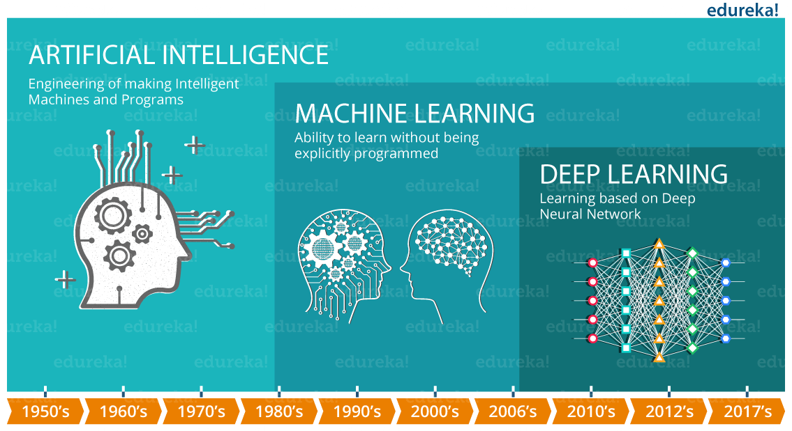
Subsets Period

Slide 37
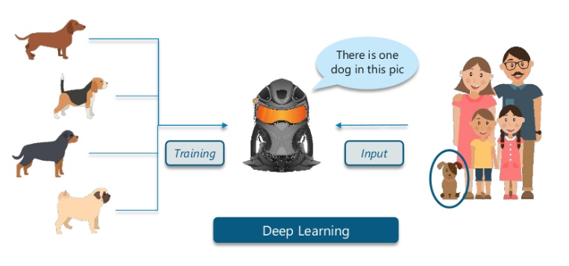
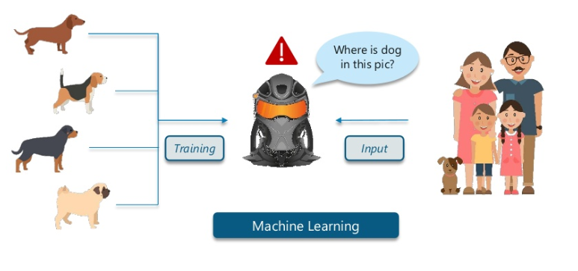
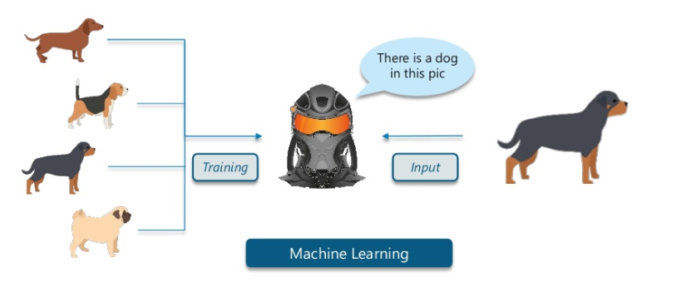
Machine Learning
Deep Learning

Slide 38
So, What Machine Learning is?

Slide 39
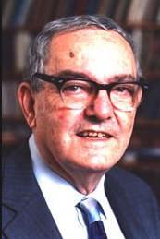
Machine Learning
Learning is any process by which a system improves performances from experience.
Machine Learning is concerned with computer programs that automatically improve their performance through experience
Herbert Alexander Simon
June 1916 – February 2001
Notes:
was an American economist and political scientist whose primary interest was decision-making within organizations and is best known for the theories of "bounded rationality" and "satisficing". He received the Nobel Prize in Economics in 1978 and the Turing Award in 1975. His research was noted for its interdisciplinary nature and spanned across the fields of cognitive science, computer science, public administration, management, and political science.

Slide 40
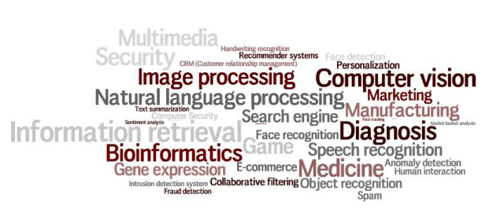
ML Applications

Slide 41
What Exactly
Deep Learning is?

Slide 42
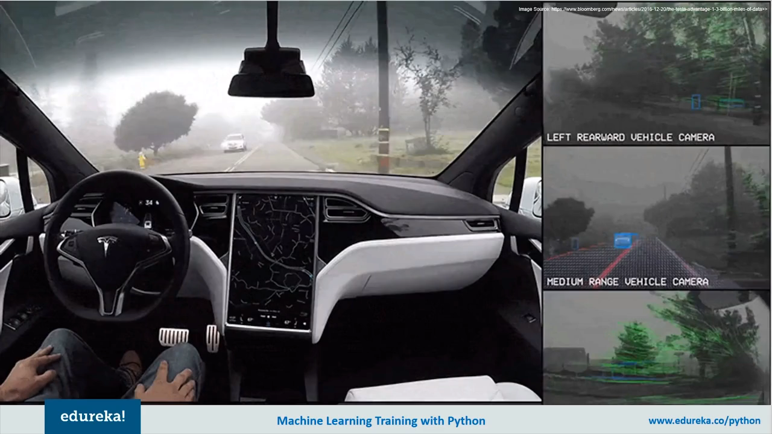
Deep Learning Example

Slide 43
Deep Learning Example

Slide 44
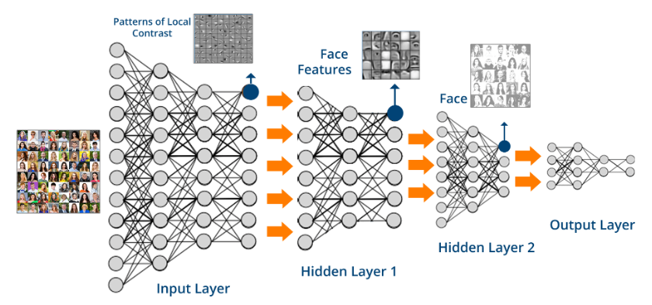
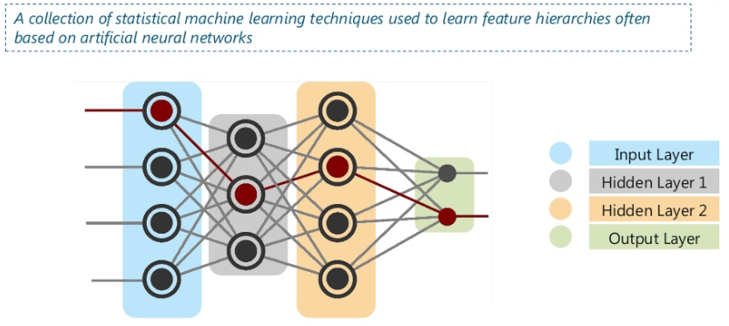
Deep Learning

Slide 45
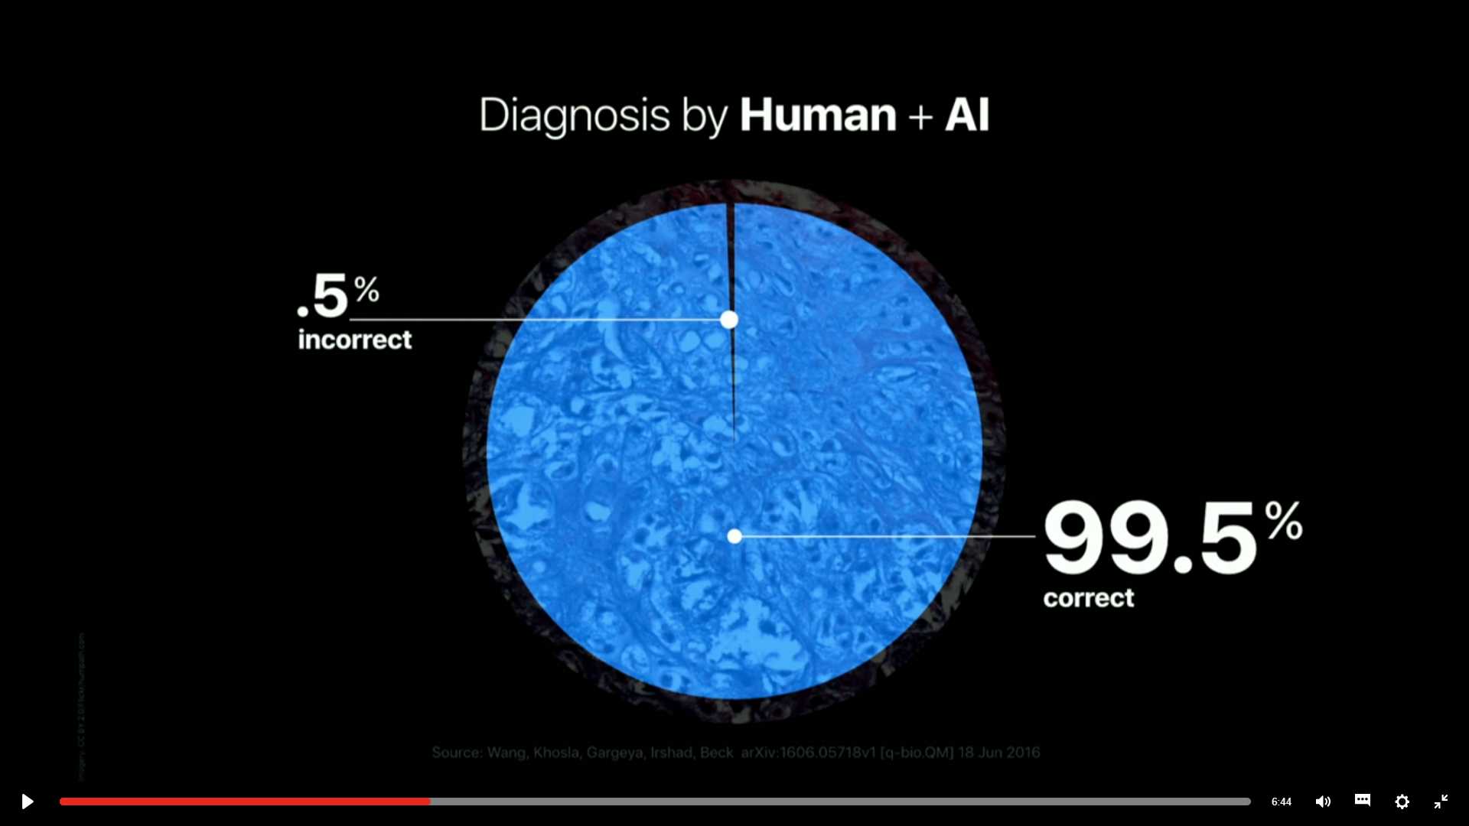
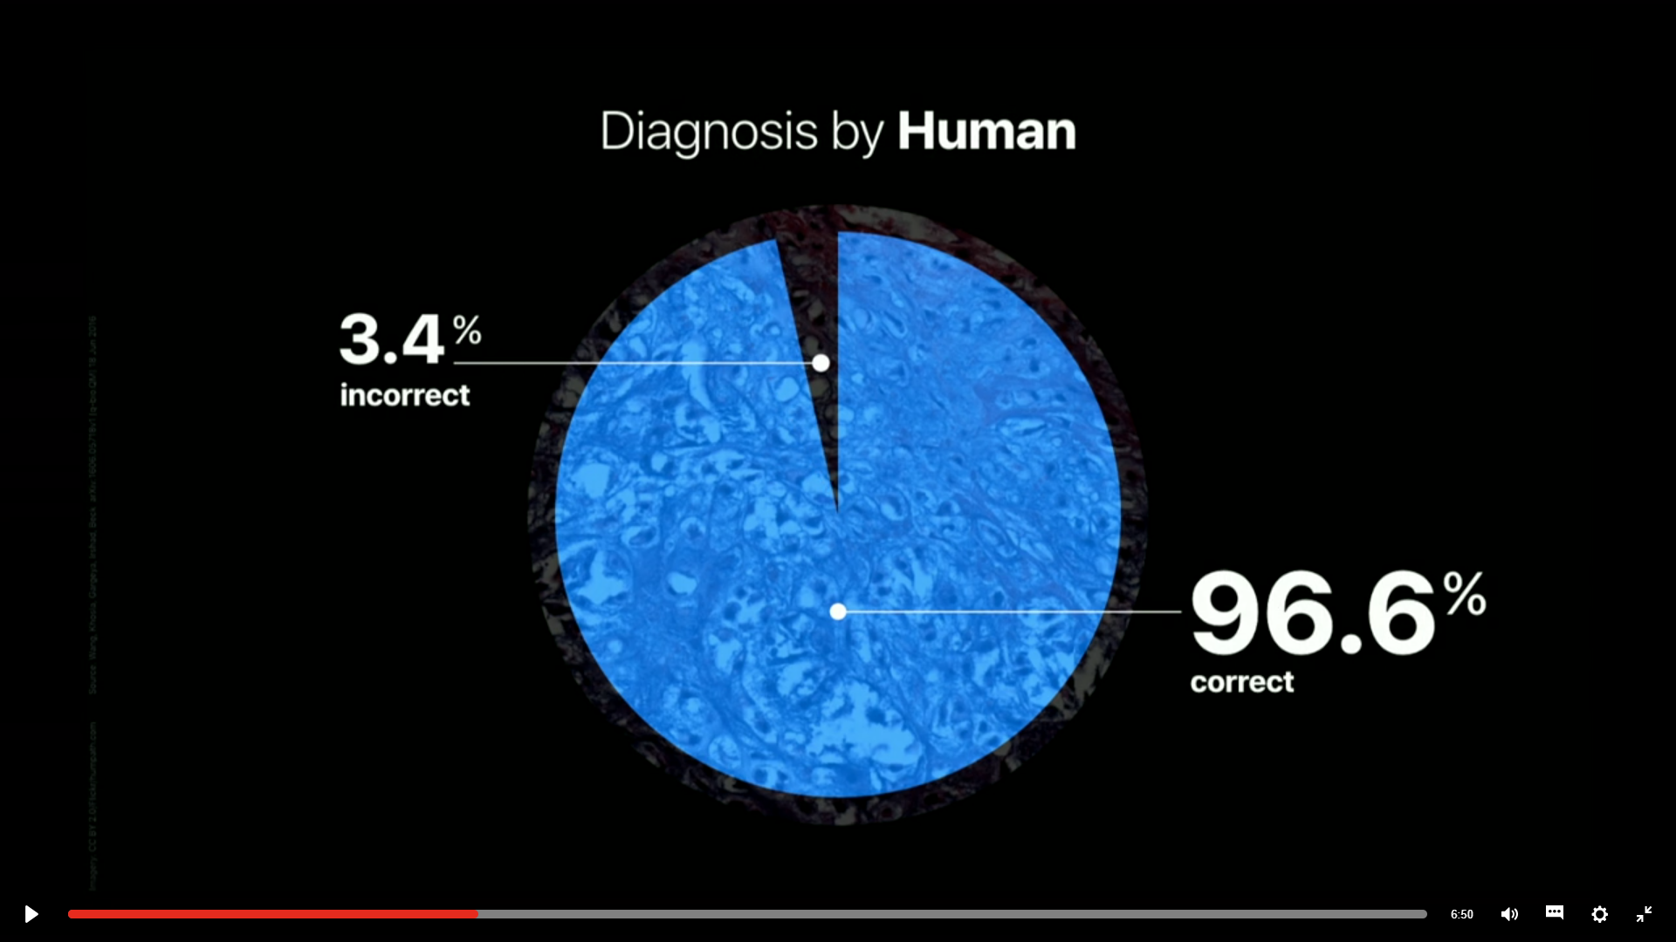
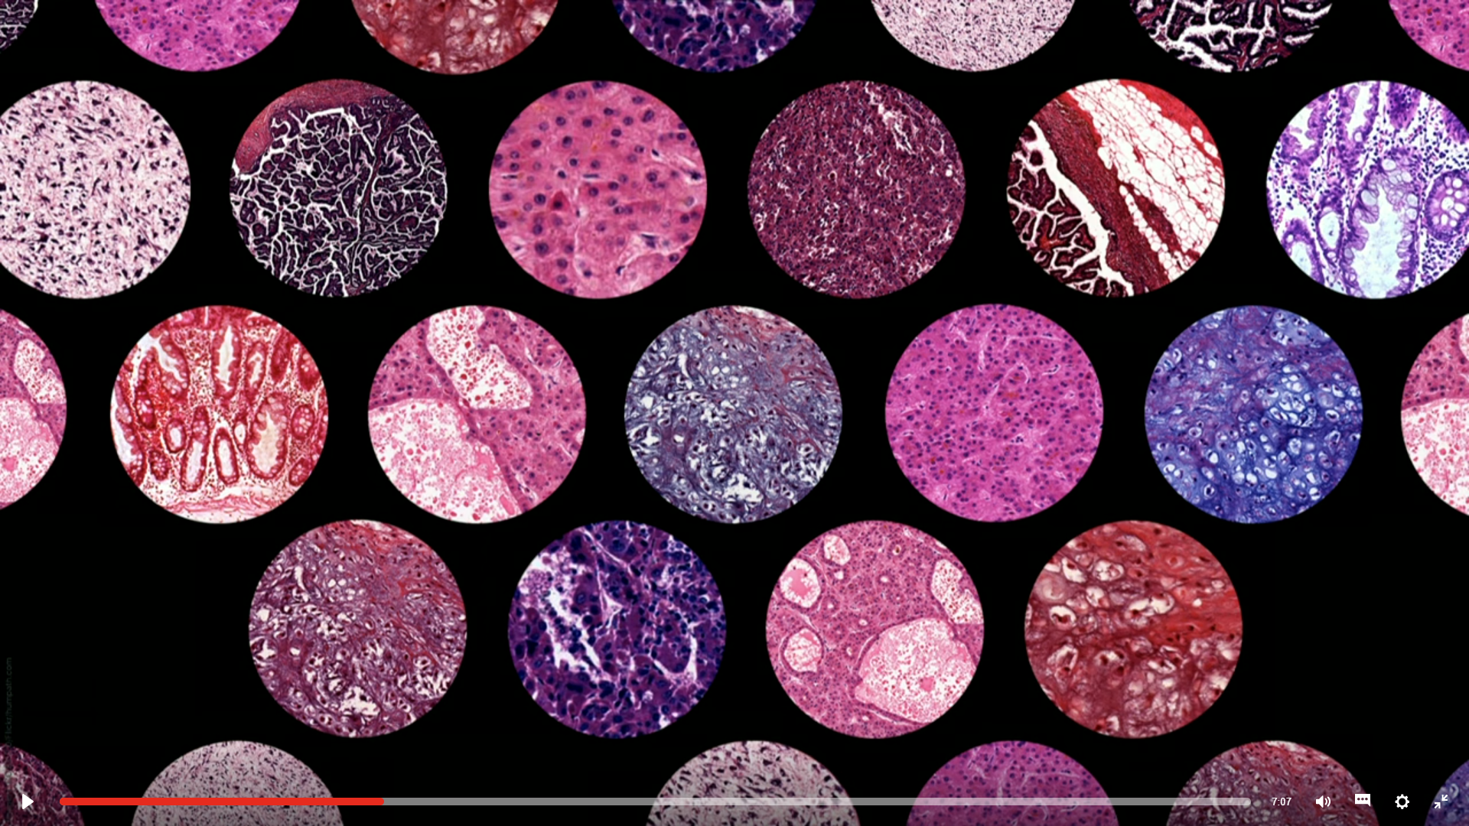
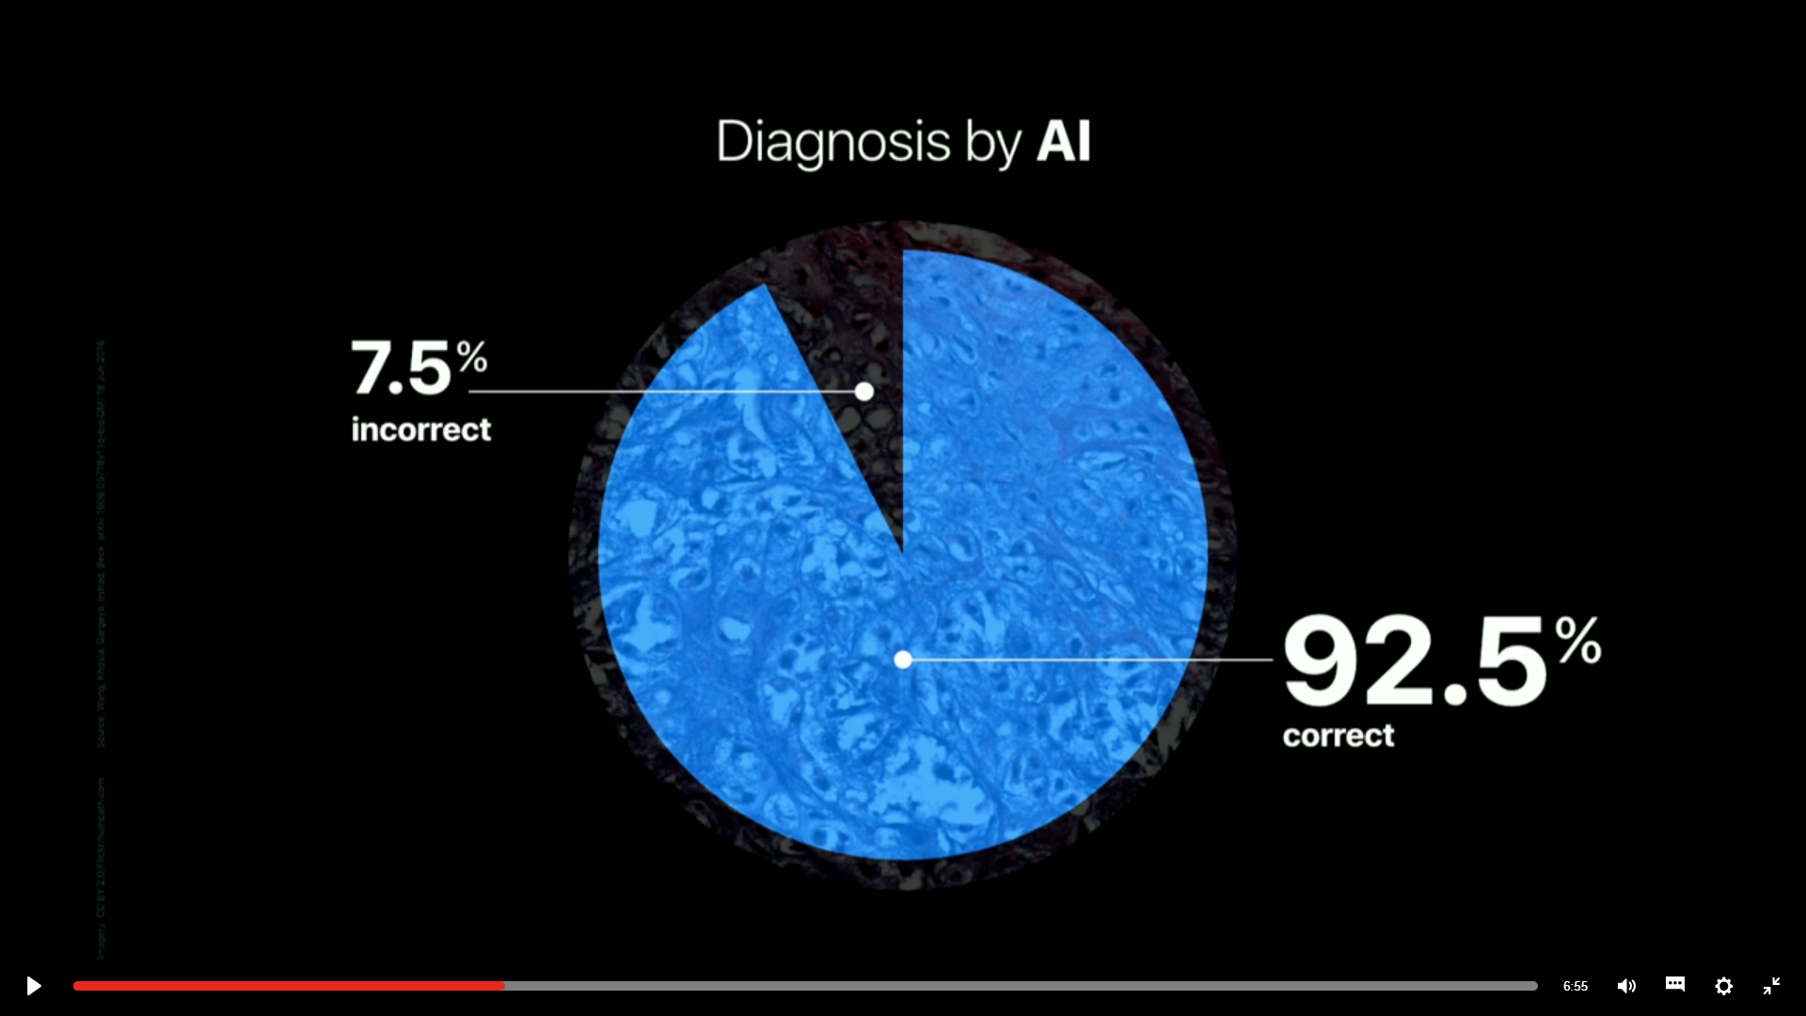
Deep Learning Example

Slide 46
Learning
Algorithm

Slide 47
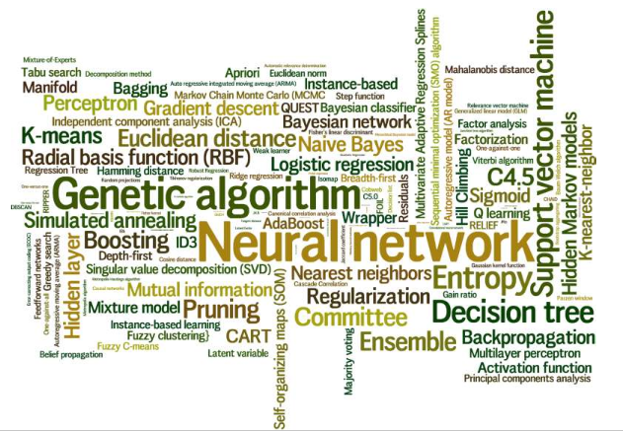
Algorithms
Notes:
https://docs.microsoft.com/en-us/azure/machine-learning/studio/algorithm-choice

Slide 48
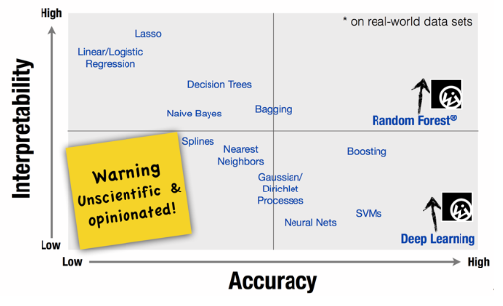
Algorithmic Trade-off
Notes:
interpretable = di tafsirkan

Slide 49
Basic
Concept

Slide 50
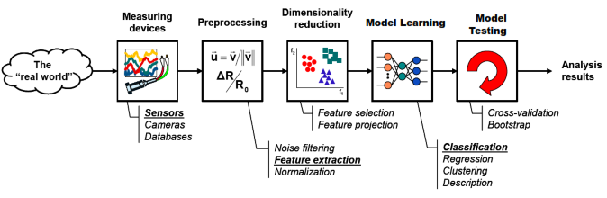
Basic Concepts

Slide 51
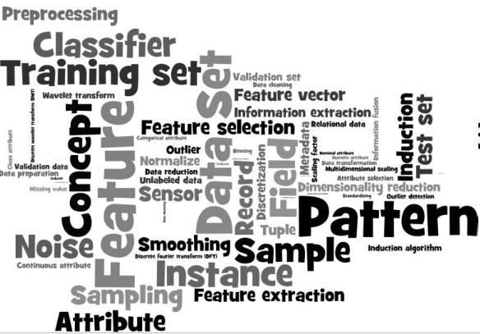
Basic Concepts

Slide 52
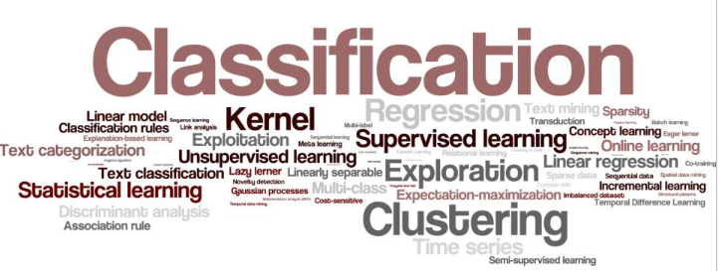
Basic Concepts

Slide 53
What kind of frameworks can be used?

Slide 54




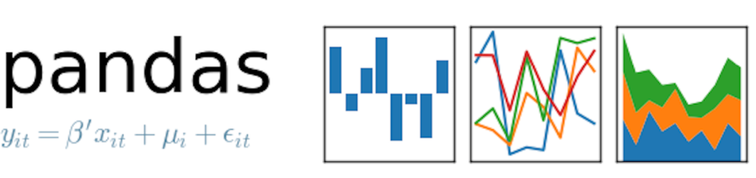




Frameworks

Slide 55
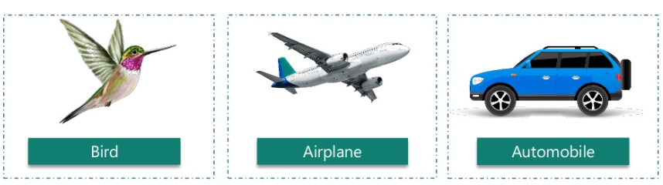
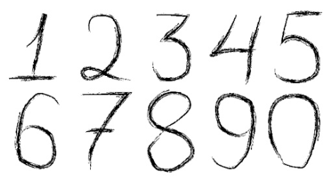


Tensorflow

Slide 56
Confusing which algorithm
you wan to use?

Slide 57
Tips
1
2
Understand Your Data
Clean Your Data
The type and kind of data we have plays a key role in deciding which algorithm to use. Some algorithms can work with smaller sample sets while others require tons and tons of samples. Certain algorithms work with certain types of data. E.g. Naïve Bayes works well with categorical input but is not at all sensitive to missing data.
Deal with missing value. Missing data affects some models more than others. Even for models that handle missing data, they can be sensitive to it (missing data for certain variables can result in poor predictions). Does the data needs to be aggregated
4
3
Augment your data
Categorize the problem
Make the models easier to interpret (e.g. binning)
Capture more complex relationships (e.g. NNs)
Reduce data redundancy and dimensionality (e.g. PCA)
Rescale variables (e.g. standardizing or normalizing)
Categorize the problem by input and output side. Whether the data is labeled? if yes, then supervised learning problem. If the output model is number, its regression problem, when it’s a class then classification, when it’s a set of input group then clustering problem
Notes:
https://hackernoon.com/choosing-the-right-machine-learning-algorithm-68126944ce1f
https://blog.statsbot.co/machine-learning-algorithms-183cc73197c
https://docs.microsoft.com/en-us/azure/machine-learning/studio/algorithm-choice

Slide 58
Tips
5
6
Understand Your Constraints
Find the available algorithms
Does the prediction have to be fast? In real time applications, it is obviously very important to have a prediction as fast as possible. For instance, in autonomous driving, it’s important that the classification of road signs be as fast as possible to avoid accidents.
Whether the model meets the business goals
How much pre processing the model needs
How accurate the model is
How explainable the model is
How fast the model is: How long does it take to build a model, and how long does the model take to make predictions.
How scalable the model is
7
Size of training set
a small training set, high bias/low variance classifiers (e.g., Naive Bayes) have an advantage over low bias/high variance classifiers (e.g., kNN), since the latter will overfit. But low bias/high variance classifiers start to win out as training set grows (they have lower asymptotic error), since high bias classifiers aren’t powerful enough to provide accurate models
Notes:
https://hackernoon.com/choosing-the-right-machine-learning-algorithm-68126944ce1f

Slide 59
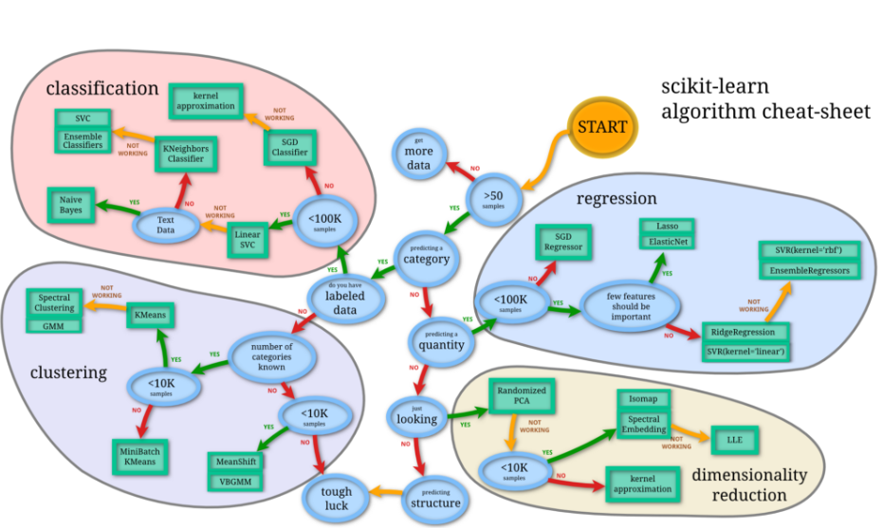
Tips
Notes:
https://hackernoon.com/choosing-the-right-machine-learning-algorithm-68126944ce1f

Slide 60
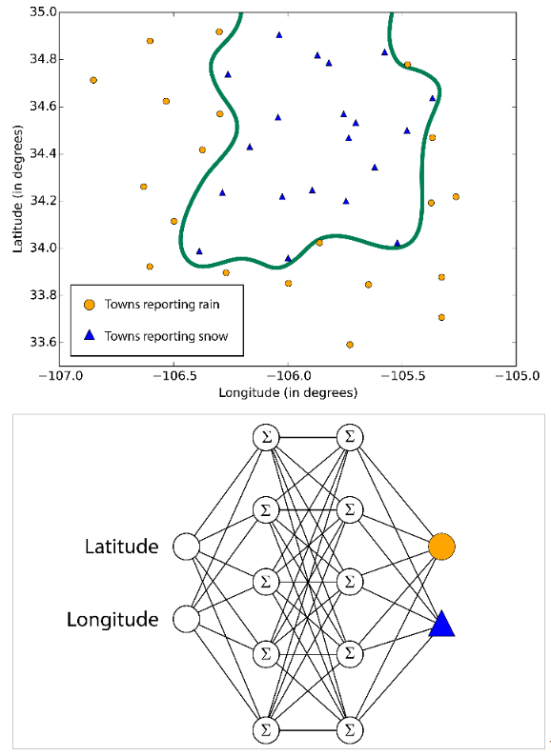
Tips

Slide 61
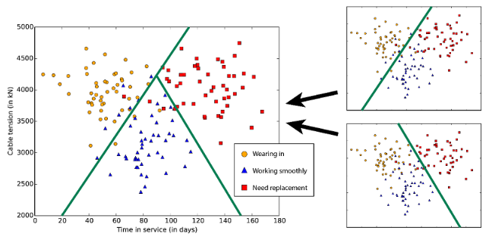
Tips

Slide 62
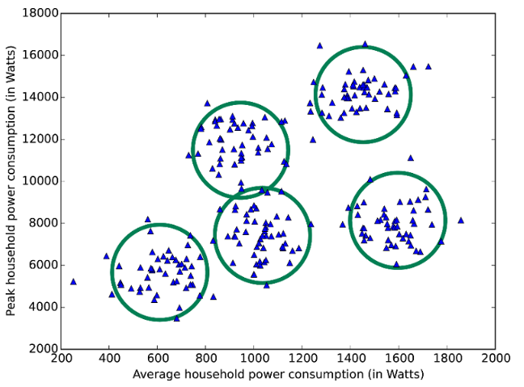
Tips

Slide 63
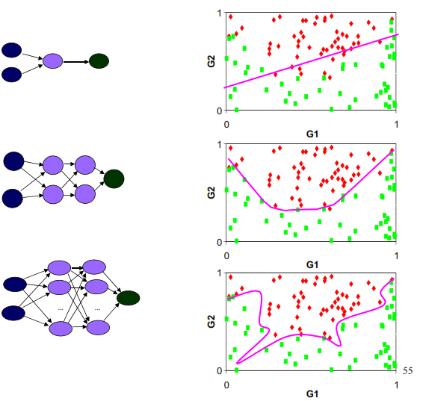
Tips

Slide 64


Slide 65


Slide 66


Slide 67
THANK YOU
Notes:
https://www.kaggle.com/dansbecker/rectified-linear-units-relu-in-deep-learning
https://pytorch.org/tutorials/intermediate/char_rnn_classification_tutorial.html

